Slide 1
CSC 3210 Computer Organization and Programming
Chapter 8: Advanced Procedures (Stack Frame)

Slide 2
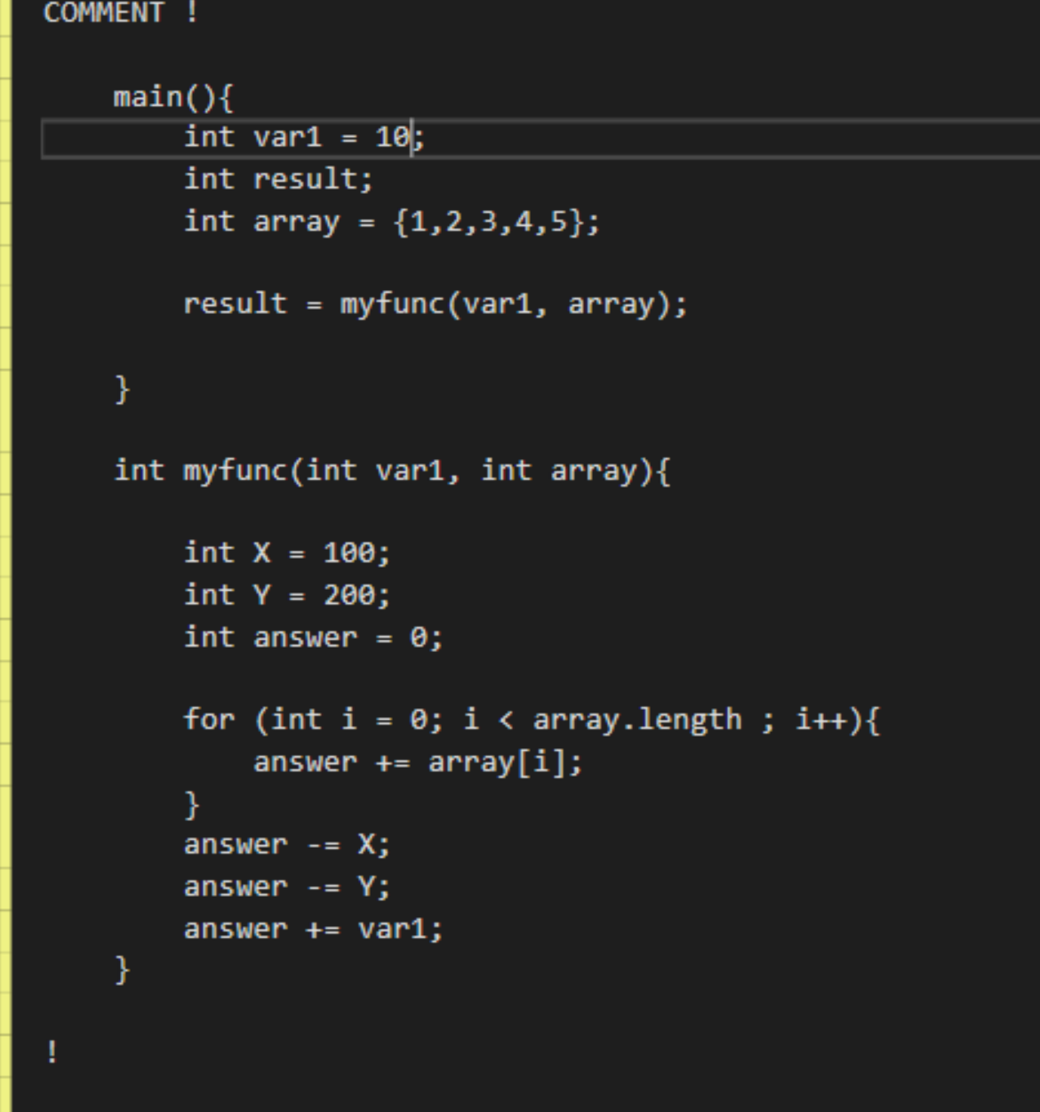

Slide 3
Outline
Stack Overview
Stack Frame
Stack Parameters
Passing Arguments
Accessing Stack Parameters
Cleaning Up the Stack
Saving and Restoring Registers
Local Variables
Reference Parameters
Recursion
INVOKE, ADDR, PROC, and PROTO

Slide 4
Stack Overview
Push
Pop
.stack 4096

Slide 5
Stack Overview: CALL-RET
Stack
The CALL instruction pushes 00000025 onto the stack, and loads 00000040 into EIP
main PROC
00000020 call MySub
00000025 mov eax,ebx
.
.
main ENDP
MySub PROC
00000040 mov eax,edx
.
.
ret
MySub ENDP
Stack
The RET instruction pops 00000025 from the stack into EIP
(stack shown before RET executes)

Slide 6
Stack Overview: Nested Calls
By the time Sub3 is called, the stack contains all three return addresses (main, sub1, sub2):
Stack
After the return,
ESP points to the next-highest stack entry.
Finally, when Sub1 returns, stack[ESP] is popped into the instruction pointer, and execution resumes in main:

Slide 7
Outline
Stack Overview
Stack Frame
Stack Parameters
Passing Arguments
Accessing Stack Parameters
Cleaning Up the Stack
Saving and Restoring Registers
Local Variables
Reference Parameters
Recursion
INVOKE, ADDR, PROC, and PROTO

Slide 8
Stack Frame
Stack Frame, also known as an activation record
Area of the stack set aside for a procedure's:
passed parameters, return address, saved registers, and local variables
Caller Stack Frame
The structure of a stack frame is directly affected by a program’s memory model & its argument passing convention
,ESP
Callee Stack Frame
[EBP - 12]
[EBP - 16]

Slide 9
Stack Frame: ESP and EBP
ESP: a register that contains the address of the top of the stack
EBP: a register that points at the top of the stack when the function is first called
These two registers are the heart of the x86 function-call mechanism
Why not use just the ESP?
Stack Frame
,ESP
[EBP - 12]
[EBP - 16]

Slide 10
Stack Frame: EBP (Why EBP?)
Function arguments and local variables are stored at an offset from where the ESP is when the function starts
As ESP grows and shrinks during a function calls:
the offset of local variables and function parameters relative to ESP changes
To simplify things, x86 uses a base pointer (sometimes called a frame pointer) that is stored in EBP.
Stack Frame
,ESP
[EBP - 12]
[EBP - 16]

Slide 11
Stack Frame: EBP (Why EBP?)
Stack Frame
EBP was designed to provide a “Base Pointer” for the current function so parameters and local variables would be at a fixed offset from the base pointer even if ESP moved with push and pop instructions
,ESP
[EBP - 12]
[EBP - 16]

Slide 12
Stack Frame: Creation
Created by the following steps:
Calling program pushes
arguments, if any, and
return address on the stack,
and calls the procedure
The called procedure pushes
EBP on the stack, and
sets EBP to ESP [from this point on, EBP acts as a base reference for all the subroutine parameters]
Stack Frame
Caller
,ESP
Collee
[EBP - 12]
[EBP - 16]

Slide 13
Stack Frame: Creation
Created by the following steps:
If any registers are needed,
they are pushed on the stack
If local variables are needed,
a constant is subtracted from ESP to make room on the stack
Stack Frame
Caller
,ESP
Collee
[EBP - 12]
[EBP - 16]

Slide 14
Outline
Stack Overview
Stack Frame
Stack Parameters
Passing Arguments
Accessing Stack Parameters
Cleaning Up the Stack
Saving and Restoring Registers
Local Variables
Reference Parameters
Recursion
Stack Frame
Caller
,ESP
Collee
[EBP - 12]
[EBP - 16]

Slide 15
Stack Frame: Stack Parameters (Why?)
The procedures we have used so far incorporate the general purpose registers to pass
parameters to one another:
This is okay except when you create subroutines that require several (> 8, 😟) parameters
In this case you will need to use the stack to pass the parameters
EAX, ECX, EDX, EBX, ESP, EBP, ESI, EDI

Slide 17
Outline
Stack Overview
Stack Frame
Stack Parameters
Passing Arguments
Accessing Stack Parameters
Cleaning Up the Stack
Saving and Restoring Registers
Local Variables
Reference Parameters
Recursion
Stack Frame
,ESP
[EBP - 12]
[EBP - 16]

Slide 18
Stack Frame: Passing Arguments
Two general types of arguments are pushed on the stack during subroutine calls:
Value arguments (values of variables and constants),
Reference arguments (addresses of variables)
Passing by Value
When an argument is passed by value, a copy of the value is pushed on the stack

Slide 19
Stack Frame: Passing Arguments
Passing by Reference
An argument passed by reference consists of the address (offset) of an object
The following statements call Swap, passing the two arguments by reference:
Passing Arrays:
[EBP + 8]

Slide 20
Outline
Stack Overview
Stack Frame
Stack Parameters
Passing Arguments
Accessing Stack Parameters
Cleaning Up the Stack
Saving and Restoring Registers
Local Variables
Reference Parameters
Recursion
Stack Frame
,ESP
[EBP - 12]
[EBP - 16]

Slide 21
Stack Frame: Accessing Stack Parameters
Base-Offset Addressing
EBP is the base register and the offset is a constant.
A function call such as AddTwo(5, 6) would cause the second parameter to be pushed on the stack, followed by the first parameter:
32-bit values are usually returned in EAX
Notes:
Begin with a prologue consisting of statements that Save the EBP register and point EBP to the top of the stack. Optionally, they may
push certain registers on the stack whose values will be restored when the function returns. The
end of the function consists of an epilogue in which the EBP register is restored and the RET
instruction returns to the caller.

Slide 22
Stack Frame: Accessing Stack Parameters
Base-Offset Addressing
🍰
😱
Notes:
Begin with a prologue consisting of statements that Save the EBP register and point EBP to the top of the stack. Optionally, they may
push certain registers on the stack whose values will be restored when the function returns. The
end of the function consists of an epilogue in which the EBP register is restored and the RET
instruction returns to the caller.

Slide 23
Outline
Stack Overview
Stack Frame
Stack Parameters
Passing Arguments
Accessing Stack Parameters
Cleaning Up the Stack
Saving and Restoring Registers
Local Variables
Reference Parameters
Recursion
Stack Frame
,ESP
[EBP - 12]
[EBP - 16]

Slide 24
Stack Frame: Cleaning Up the Stack
There must be a way for parameters to be removed from the stack when a subroutine returns
Otherwise, a memory leak would result, and the stack would become corrupted.
Example1 Proc Frame🙃
main PROC
call Example1
exit
main ENDP
Example1 PROC
push 6
push 5
call AddTwo
ret
Example1 ENDP

Slide 25
Stack Frame: Cleaning Up the Stack
There must be a way for parameters to be removed from the stack when a subroutine returns
Otherwise, a memory leak would result, and the stack would become corrupted.
Example1 Proc Frame🙃
main PROC
call Example1
exit
main ENDP
Example1 PROC
push 6
push 5
call AddTwo
ret ; stack is corrupted!
Example1 ENDP

Slide 26
Stack Frame: Cleaning Up the Stack
The solution is to use one of the calling conventions:
The C Calling Convention
STDCALL Calling Convention

Slide 27
Stack Frame: Cleaning Up the Stack
The C Calling Convention:
Follow CALL instruction with a statement that adds a value to the ESP equal to the combined sizes of the subroutine parameters

Slide 28
Stack Frame: Cleaning Up the Stack
STDCALL Calling Convention
It supplies an integer parameter to the RET instruction
The integer must equal the number of bytes of stack space consumed by the procedure’s parameters:
STDCALL, like C, pushes arguments onto the stack in reverse order

Slide 29
Outline
Stack Overview
Stack Frame
Stack Parameters
Passing Arguments
Accessing Stack Parameters
Cleaning Up the Stack
Saving and Restoring Registers
Local Variables
Reference Parameters
Recursion
Stack Frame
,ESP
[EBP - 12]
[EBP - 16]
Notes:
Tu, 9:30, Nov7

Slide 30
Stack Frame: Saving and Restoring Registers
Registers in question should be pushed on the stack (Rules)
just after setting EBP to ESP, and just before reserving space for local variables
This helps to avoid changing offsets of existing stack parameters.

Slide 31
Outline
Stack Overview
Stack Frame
Stack Parameters
Passing Arguments
Accessing Stack Parameters
Cleaning Up the Stack
Saving and Restoring Registers
Local Variables
Reference Parameters
Recursion
Stack Frame
,ESP
[EBP - 12]
[EBP - 16]
Notes:
Tu, Nov 7, 4pm
Sec03, 17Apr

Slide 32
Stack Frame: Local Variables
Local variables are created on the runtime stack, usually below the base pointer (EBP)
They cannot be assigned default values at assembly time, BUT can be initialized at runtime
EXAMPLE1:
Cannot be assigned default values at assembly time
initialized at runtime

Slide 33
Stack Frame: Local Variables
EXAMPLE2:
What if you did not have this

Slide 34
Attendance

Slide 35
Outline
Stack Overview
Stack Frame
Stack Parameters
Passing Arguments
Accessing Stack Parameters
Cleaning Up the Stack
Saving and Restoring Registers
Local Variables
Reference Parameters
Recursion
Stack Frame
,ESP
[EBP - 12]
[EBP - 16]
Notes:
W1, 3pm, Nov-06

Slide 36
Stack Frame: Reference Parameters
Reference parameters are usually accessed by procedures using base-offset addressing (from EBP)
Because each reference parameter is a pointer, it is usually loaded into a register as an indirect operand
EXAMPLE1:
Suppose that a pointer to an array is located at stack address [ebp12]
The following statement copies the pointer into ESI:
mov esi,[ebp+12] ; points to the array

Slide 37
Stack Frame: Reference Parameters
EXAMPLE2:

Slide 38
Stack Frame: Reference Parameters
EXAMPLE2:

Slide 39
Outline
Stack Overview
Stack Frame
Stack Parameters
Passing Arguments
Accessing Stack Parameters
Cleaning Up the Stack
Saving and Restoring Registers
Local Variables
Reference Parameters
Recursion
Stack Frame
Caller
,ESP
Collee
[EBP - 12]
[EBP - 16]

Slide 40
Recursion
A recursive subroutine is one that calls itself, either directly or indirectly.
The process created when . . .
A procedure calls itself
Procedure A calls procedure B, which in turn calls procedure A
Using a graph in which each node is a procedure and each edge is a procedure call, recursion forms a cycle:

Slide 42
Recursion
Endless Recursion:
The RET instruction is never executed
The program halts when the stack overflows

Slide 43
Recursion with break condition

Slide 44
Recursion: Recursively Calculating a Factorial
Recursive subroutines often store temporary data in stack parameters
When the recursive calls unwind, the data saved on the stack can be useful
EXAMPLE:
calculate 5!

Slide 45
Recursion: Recursively Calculating a Factorial
Recursive subroutines often store temporary data in stack parameters
When the recursive calls unwind, the data saved on the stack can be useful
EXAMPLE:
calculate 5!

Slide 46
Recursion: Recursively Calculating a Factorial
Let’s examine the Factorial procedure more closely by tracking a call to it with an initial value of N = 3.
3
3!

Slide 48
Recursion: Recursively Calculating a Factorial
Let’s examine the Factorial procedure more closely by tracking a call to it with an initial value of N = 3.
3
3!
1

Slide 49
1
2

Slide 50
3

Slide 51
4

Slide 54
The return value in EAX, 6, is the computed value of 3 factorial.

Slide 55
Outline
Stack Overview
Stack Frame
Stack Parameters
Passing Arguments
Accessing Stack Parameters
Cleaning Up the Stack
Saving and Restoring Registers
Local Variables
Reference Parameters
Recursion
INVOKE, ADDR, PROC, and PROTO

Slide 56
INVOKE, ADDR, PROC, and PROTO
INVOKE Directive
ADDR Operator
PROC Directive
PROTO Directive
Parameter Classifications
Example: Exchanging Two Integers
Debugging Tips

Slide 57
INVOKE Directive
Not in 64-bit mode!
In 32-bit mode, the INVOKE directive is a powerful
replacement for Intel’s CALL instruction that lets you pass multiple arguments
Syntax:
INVOKE procedureName [, argumentList]
ArgumentList is an optional comma-delimited list of procedure arguments
Arguments can be:
immediate values and integer expressions
variable names
address and ADDR expressions
register names

Slide 58
INVOKE Examples
.data
byteVal BYTE 10
wordVal WORD 1000h
.code
; direct operands:
INVOKE Sub1,byteVal,wordVal
; address of variable:
INVOKE Sub2,ADDR byteVal
; register name, integer expression:
INVOKE Sub3,eax,(10 * 20)
; address expression (indirect operand):
INVOKE Sub4,[ebx]

Slide 59
INVOKE, ADDR, PROC, and PROTO
INVOKE Directive
ADDR Operator
PROC Directive
PROTO Directive
Parameter Classifications
Example: Exchanging Two Integers
Debugging Tips

Slide 60
ADDR Operator
Not in 64-bit mode!
Returns a near or far pointer to a variable, depending on which memory model your program uses:
Small model: returns 16-bit offset
Large model: returns 32-bit segment/offset
Flat model: returns 32-bit offset
Simple example:
.data
myWord WORD ?
.code
INVOKE mySub,ADDR myWord

Slide 61
INVOKE, ADDR, PROC, and PROTO
INVOKE Directive
ADDR Operator
PROC Directive
PROTO Directive
Parameter Classifications
Example: Exchanging Two Integers
Debugging Tips

Slide 62
PROC Directive
Not in 64-bit mode!
The PROC directive declares a procedure with an optional list of named parameters.
Syntax:
label PROC paramList
paramList is a list of parameters separated by commas.
Each parameter has the following syntax:
paramName : type
type must either be one of the standard ASM types (BYTE, SBYTE, WORD, etc.),
or it can be a pointer to one of these types.
You can refer to parameter by name instead of calculating the stack offsets (such as [ebp+8] )

Slide 63
PROC Directive
Alternate format permits parameter list to be on one or more separate lines:
label PROC,
paramList
The parameters can be on the same line . . .
param-1:type-1, param-2:type-2, . . ., param-n:type-n
Or they can be on separate lines:
param-1:type-1,
param-2:type-2,
. . .,
param-n:type-n
comma required

Slide 64
AddTwo Procedure
The AddTwo procedure receives two integers and returns their sum in EAX.
AddTwo PROC,
val1:DWORD, val2:DWORD
mov eax,val1
add eax,val2
ret
AddTwo ENDP

Slide 65
PROC Examples
FillArray receives a pointer to an array of bytes, a single byte fill value that will be copied to each element of the array, and the size of the array.
FillArray PROC,
pArray:PTR BYTE, fillVal:BYTE,
arraySize:DWORD
mov ecx,arraySize
mov esi,pArray
mov al,fillVal
L1: mov [esi],al
inc esi
loop L1
ret
FillArray ENDP
Proc c,
Proc STDCALL,

Slide 66
INVOKE, ADDR, PROC, and PROTO
INVOKE Directive
ADDR Operator
PROC Directive
PROTO Directive
Parameter Classifications
Example: Exchanging Two Integers
Debugging Tips

Slide 67
PROTO Directive
Creates a procedure prototype
Syntax:
label PROTO paramList
Every procedure called by the INVOKE directive must have a prototype
A complete procedure definition can also serve as its own prototype
Parameter list not permitted in 64-bit mode

Slide 68
PROTO Directive
Standard configuration:
PROTO appears at top of the program listing,
INVOKE appears in the code segment,
Procedure implementation occurs later in the program:
MySub PROTO ; procedure prototype
.code
INVOKE MySub ; procedure call
MySub PROC ; procedure implementation
.
.
MySub ENDP

Slide 69
PROTO Example
Prototype for the ArraySum procedure, showing its parameter list:
ArraySum PROTO,
ptrArray:PTR DWORD, ; points to the array
szArray:DWORD ; array size
Parameters are not permitted in 64-bit mode.

Slide 70
INVOKE, ADDR, PROC, and PROTO
INVOKE Directive
ADDR Operator
PROC Directive
PROTO Directive
Parameter Classifications
Example: Exchanging Two Integers
Debugging Tips

Slide 71
Parameter Classifications
An input parameter is data passed by a calling program to a procedure.
The called procedure is not expected to modify the corresponding parameter variable, and
even if it does, the modification is confined to the procedure itself.
An output parameter is created by passing a pointer to a variable when a procedure is called.
The procedure does not use any existing data from the variable, but it fills in a new value before it returns.
An input-output parameter is a pointer to a variable containing input that will be both used and modified by the procedure.
The variable passed by the calling program is modified.

Slide 72
Trouble-Shooting Tips
Save and restore registers when they are modified by a procedure.
Except a register that returns a function result
When using INVOKE, be careful to pass a pointer to the correct data type.
For example, MASM cannot distinguish between a DWORD argument and a PTR BYTE argument.
Do not pass an immediate value to a procedure that expects a reference parameter.
Dereferencing its address will likely cause a general-protection fault.

